Slide 1

CRM Analytics

Slide 2

Group 5
DEEPAK KUMAR JENA
DEOYANI DEORAO CHOUDHARI
MALLAM SUDHARSHAN REDDY
NAVYA A
RAAM CHARAN C
RAJSHEKAR SWAMY
SWETHA

Slide 3
PROJECT SUMMARY
Objective: CRM analytics to improve customer retention, optimize sales strategies, and enhance marketing effectiveness.
Scope: Customer segmentation, sales trends, campaign effectiveness, churn analysis.
Methodology: Data-driven insights using Excel, Power-BI, Tableau, and MySQL..
Key Findings/Insights: Identified trends in opportunity success, forecasting accuracy and sales efficiency.
Outcomes/Impact: Improved decision-making, better resource allocation, and enhanced revenue growth.
Tools/Technologies Used: Excel, Tableau, Power BI & SQL.

Slide 4
KPI List Opportunity Dashboard
Total Expected Amount - 184.14 M
Represents the total potential revenue that can be generated from all active and open opportunities
Conversion Rate - 35.53
It measures the percentage of opportunities that successfully convert into closed-won deals.
Total Opportunities – 4022
Represents the total count of all sales opportunities within the pipeline, providing a comprehensive view of potential revenue sources.
Won Rate - 31.06%
It shows the percentage of opportunities successfully converted into closed-won deals, reflecting sales effectiveness.
Loss Rate – 41.56%
Represents the percentage of opportunities that resulted in closed-lost deals, indicating areas for improvement in the sales process.
Active Opportunities – 78
Represents the total count of open and ongoing sales opportunities yet to be closed.

Slide 5
KPI List Lead Dashboard
Expected Amount 182.43 million
The total amount expected from leads that have successfully converted Leads.
Total Leads 10,000
The total number of leads captured in the system. Represents the overall scope of potential customers being targeted.
Converted Accounts 1,016
The number of accounts (businesses or customers) that have moved from being a lead to an active account. Reflects how effective sales process is at converting leads into accounts.
Converted Opportunities 411
The number of leads that have been qualified and converted into tangible sales opportunities. A lower number compared to total leads or accounts suggests potential bottlenecks in the qualification or nurturing process.
Lead Conversion Rate 9.84%
The percentage of total leads successfully converted into opportunities or accounts. A measure of sales efficiency; the higher the rate, the better the conversion effectiveness. A rate below 10% might indicate issues in lead quality, follow-ups, or alignment between marketing and sales teams.

Slide 6
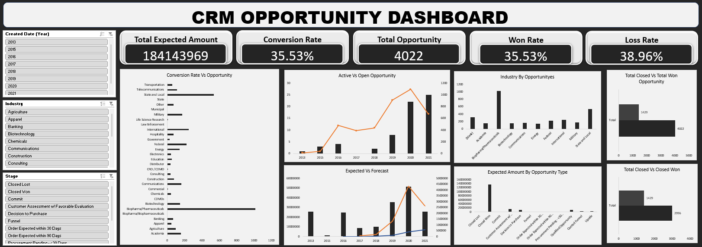
EXCEL DASHBOARD

Slide 7
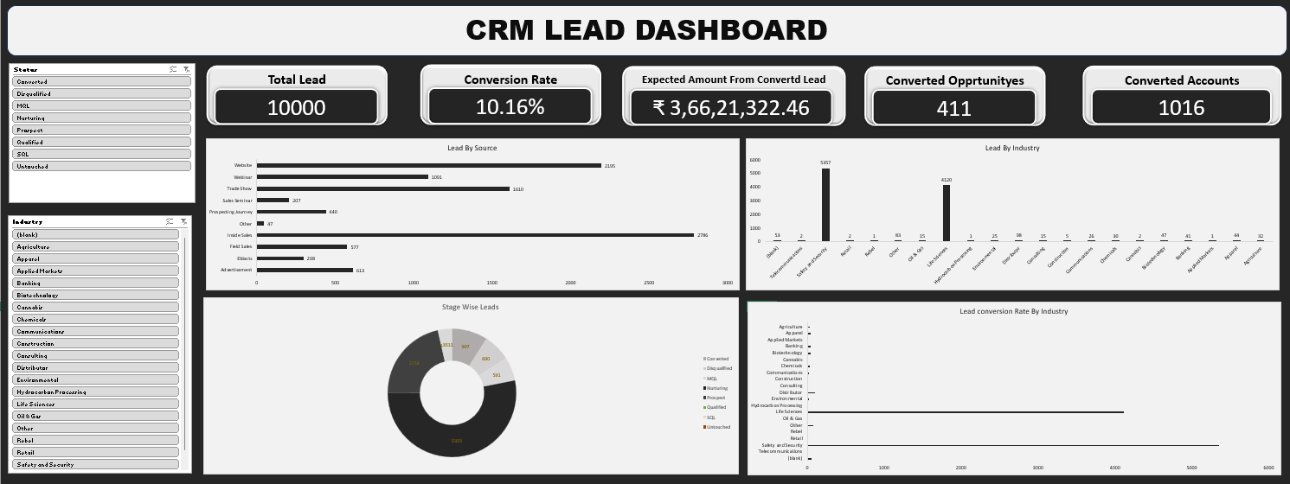
EXCEL DASHBOARD

Slide 8
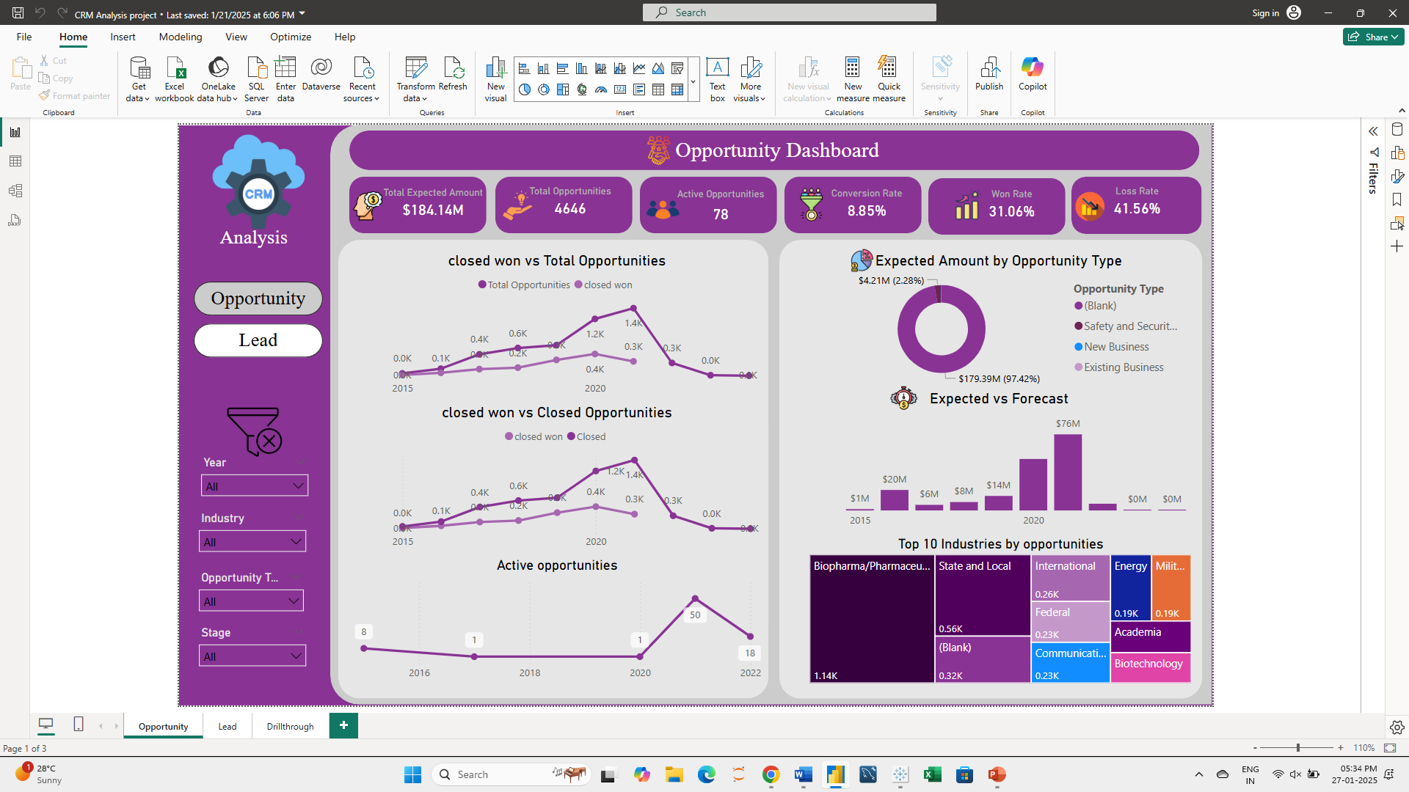
POWER-BI DASHBOARD

Slide 9
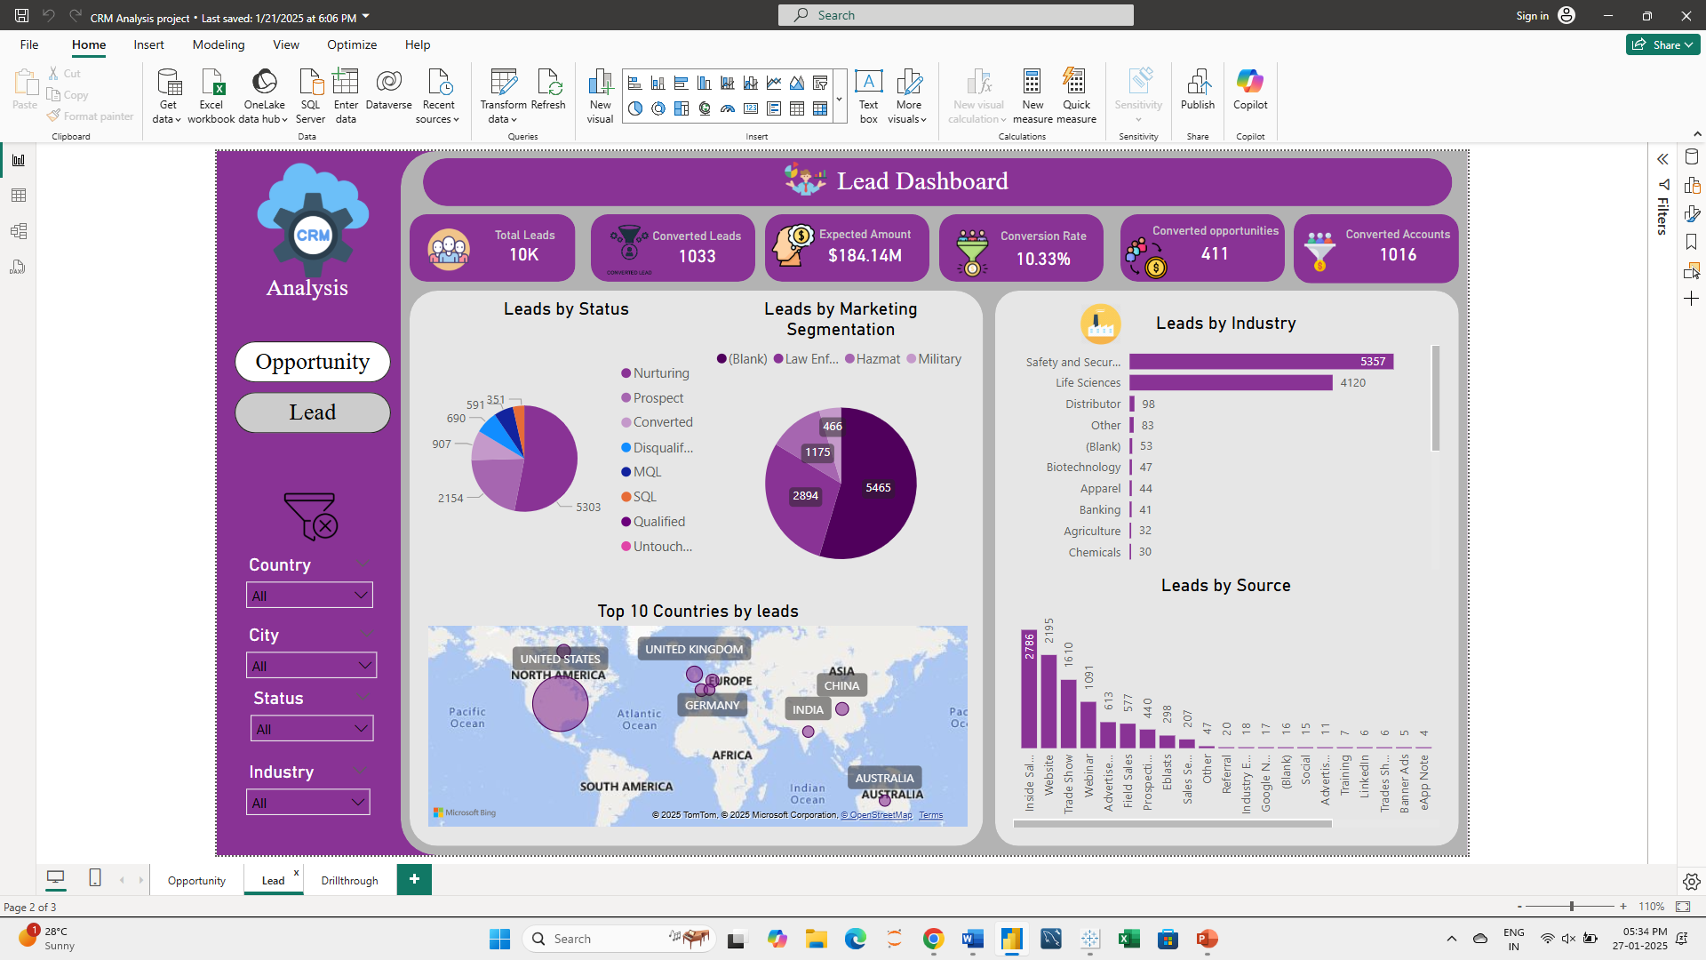
POWER-BI DASHBOARD

Slide 10
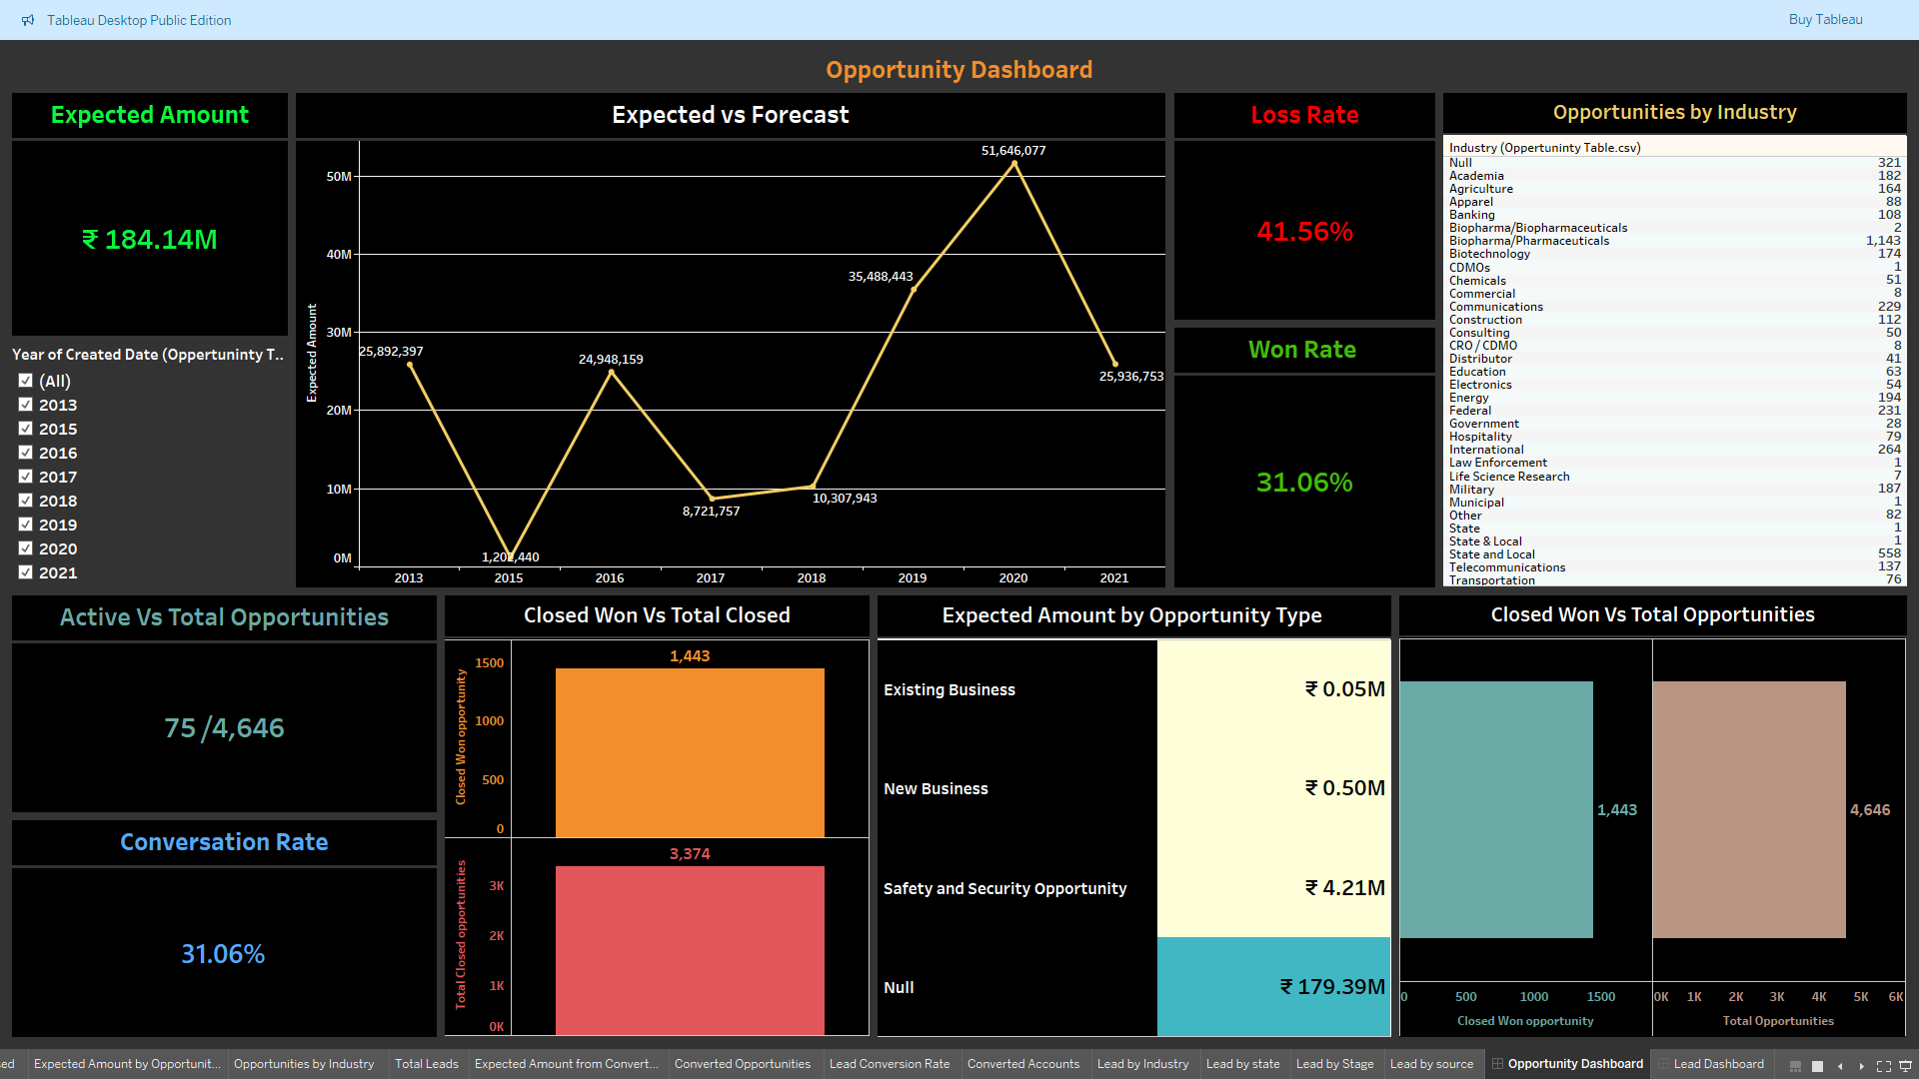
TABLEAU DASHBOARD

Slide 11
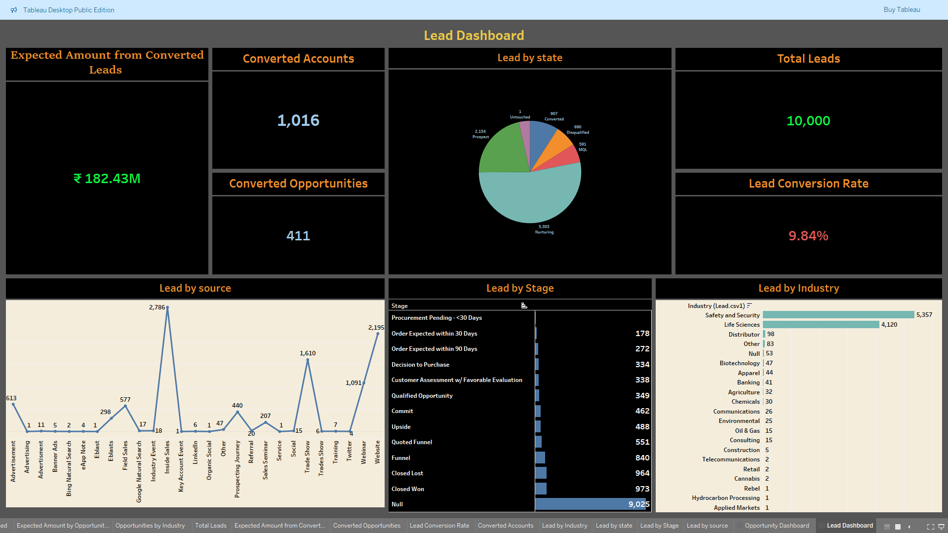
TABLEAU DASHBOARD

Slide 12
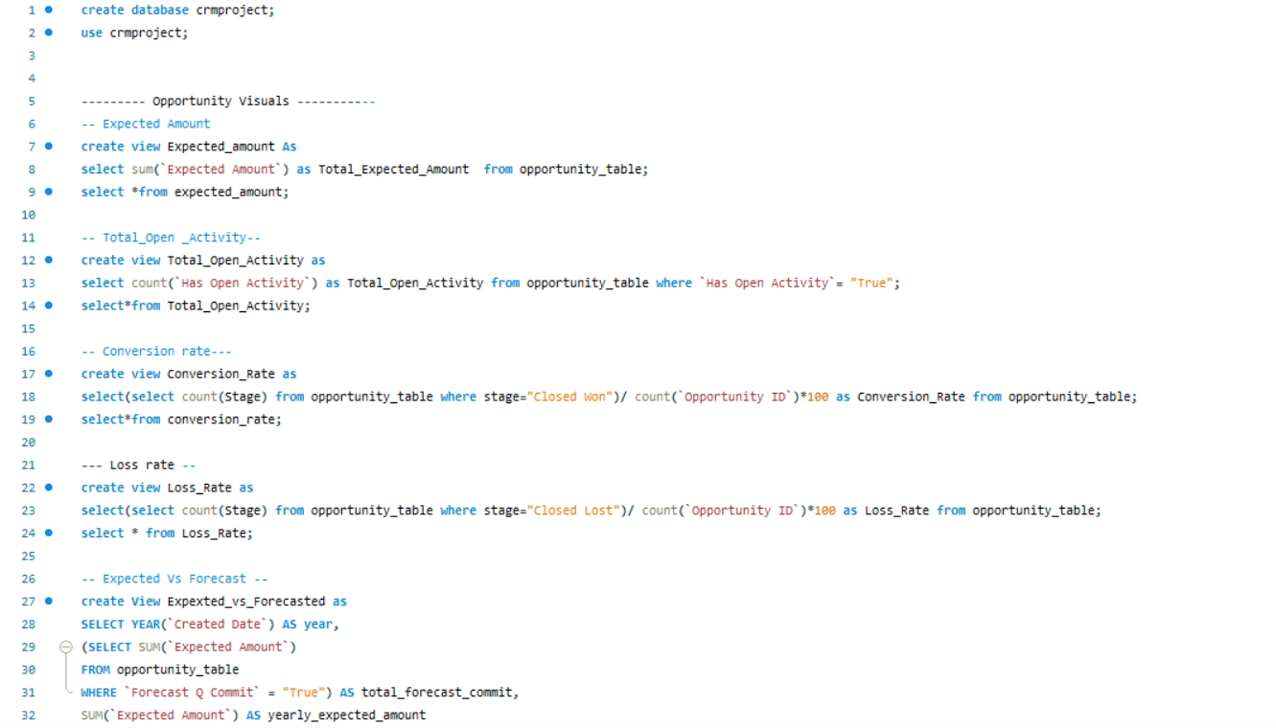
SQL QUERIES

Slide 13
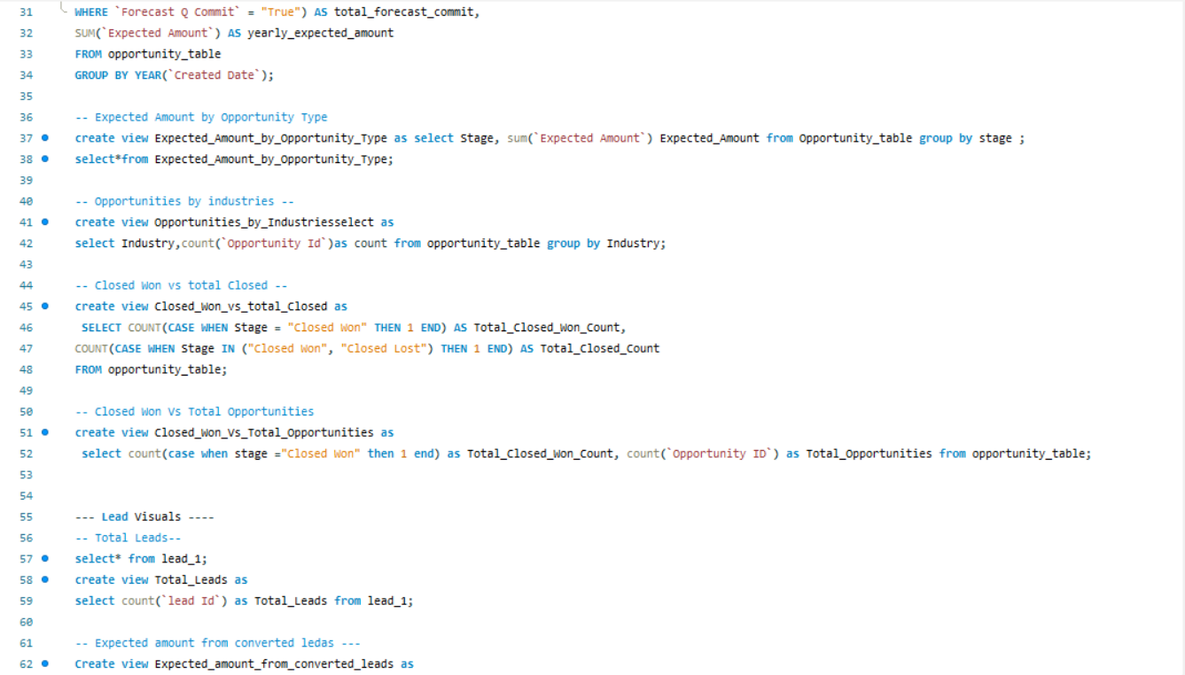
SQL QUERIES

Slide 14
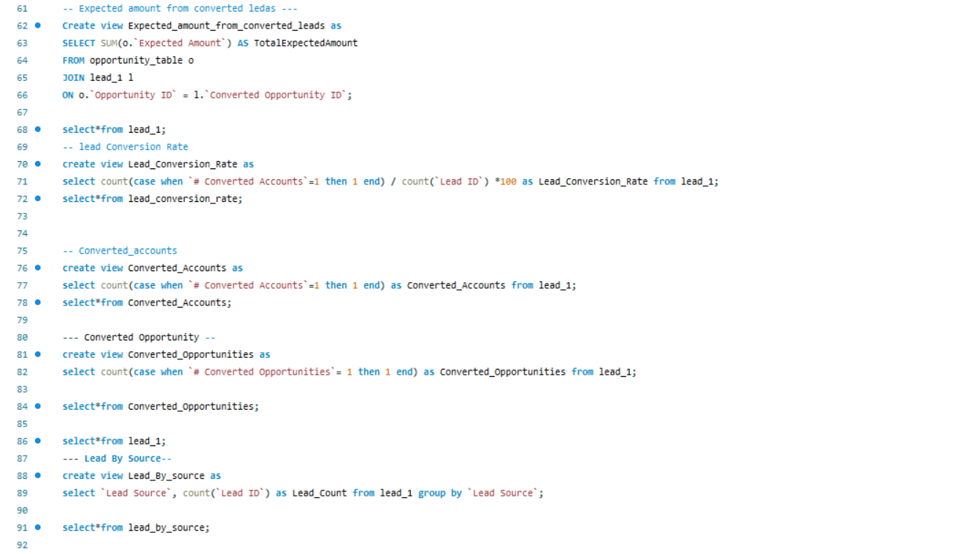
SQL QUERIES

Slide 15
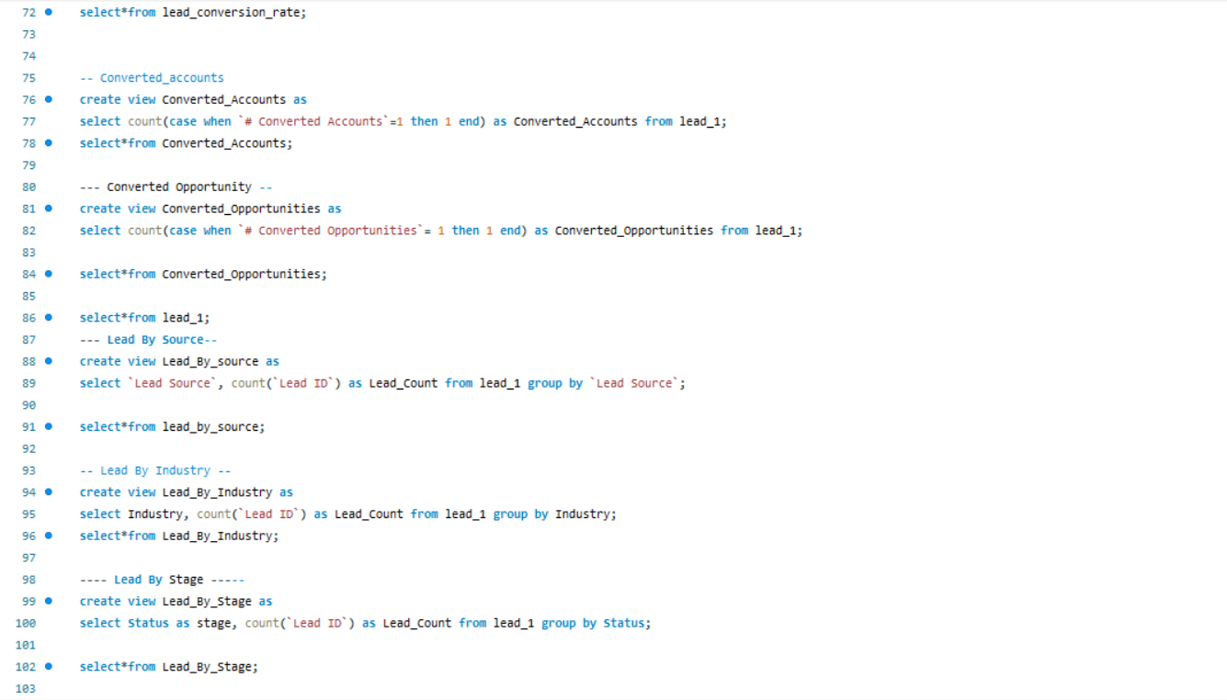
SQL QUERIES

Slide 16
KEY TAKEAWAY (OPPORTUNITY)
Focus on Retention: Analyze the high loss rate and develop strategies to improve client retention and reduce missed opportunities.
Engagement in Key Industries: Capitalize on the Biopharma/Pharmaceuticals and State and Local sectors, as they show the most promise.
Boost Active Opportunities: Only 1.6% of opportunities are actively pursued. Reallocate resources to ensure a higher percentage of active opportunities.
Address Yearly Volatility: Investigate the factors causing significant fluctuations in expected amounts across years, especially post-2020.
Enhance New Business Growth: New Business dominates in terms of expected amounts. Strengthening this segment could yield higher revenues.
Improving Win Rates: Strategize to convert more opportunities into wins, possibly by enhancing lead nurturing processes and focusing on high-priority opportunities.
Improve CRM Data Utilization: Ensure data hygiene by keeping the CRM updated with accurate opportunity stages, reasons for loss, and next steps.
Focus on Inactive Opportunities: With only 1.6% active opportunities, dedicate sales and marketing efforts to re-engage inactive opportunities.
Deep-Dive into Loss Analysis: Implement reporting on reasons for lost deals to address systemic sales or operational issues.
Leverage Automation: Use CRM tools for automated follow-ups and alerts for stagnant leads or opportunities nearing closure deadlines.
Enhance Collaboration: Improve coordination between sales, marketing, and customer success teams to drive conversions and retain customers.
Diversify the pipeline by identifying growth areas in underrepresented industries or opportunity types.

Slide 17
KEY TAKEAWAY (LEAD)
The Lead Conversion Rate is 9.84%, which is reasonable but leaves room for improvement. Improving conversion rates by even 1-2% can significantly impact revenue. Focus on improving touchpoints in the lead journey—shorten response times, personalize outreach, and address objections effectively. Implement A/B testing for email campaigns, landing pages, or sales scripts to identify high-performing strategies.
Pipeline Bottlenecks: A significant number of leads are inactive or stuck in early stages. Addressing these bottlenecks will significantly improve the lead conversion rate.
Channel Focus: Focus more on high-performing sources (e.g., Google Natural Search and Website) while optimizing or retiring unproductive channels.
Industry Diversification: Diversify efforts to reduce reliance on Safety and Security and Life Sciences, which currently dominate the funnel.
Follow-up Processes: Leads in 'Nurturing' and 'Null' stages highlight the need for better lead management and follow-up systems.
Revenue Optimization: With ₹182.43M in expected revenue, prioritizing high-value deals in advanced stages can yield faster revenue growth.

Slide 18
KEY TAKEAWAY (LEAD)
Focus on Key Industries for Growth - Industries like Safety and Security and Life Sciences dominate lead generation, while others (e.g., Retail, Construction) have negligible representation. Deepen focus on top-performing industries with tailored marketing and sales strategies. Explore growth opportunities in underrepresented sectors by analyzing their potential market demand.
Google Natural Search and Website are the most effective sources, while others like Twitter and Trade Shows are underperforming. The return on investment (ROI) from high-performing channels can be maximized further, while low-performing ones may need re-evaluation. Double down on optimizing Google Ads, SEO, and website content to capture more qualified leads. Investigate why channels like Trade Shows and Social Media yield fewer leads and adjust strategies (e.g., improve targeting or reduce investments).
A significant proportion of leads (5,303) are in the Nurturing stage. Leads are stagnating in the pipeline, indicating inefficiencies in transitioning leads from nurturing to conversion. Introduce lead scoring to prioritize high-quality leads for quicker follow-up. Enhance nurturing campaigns with personalized emails, targeted ads, or exclusive offers to move leads to the next stage faster.
A nearly 1:1 ratio of losses to wins suggests that competitors are capturing similar opportunities or that sales processes need refinement. Analyze lost deals to identify patterns, such as price objections, delayed responses, or product mismatches. Develop a post-loss follow-up process to re-engage these leads in the future.
There are 411 converted opportunities, which is less than 5% of the total leads. The qualification-to-opportunity conversion ratio is low, indicating possible inefficiencies in lead nurturing or qualification processes. Train sales teams on identifying high-potential leads earlier. Introduce incentives or tools to fast-track qualified opportunities through the funnel.

Slide 19
THANK
YOU

